Slide 1
Identifying High-Load SQL

Slide 2
Objectives
After completing this lesson, you should learn the different methods of identifying high-load SQL:
  ADDM
  Top SQL
  Dynamic performance views
  Statspack
Notes:
Objectives
Identifying high-load SQL is the first step in the SQL tuning process. In this lesson, you learn the different tools that are available for identifying high-load SQL.

Slide 3

SQL Tuning Process: Overview
Identify
high-load
SQL
Analyze SQL
Take
corrective
action
Notes:
SQL Tuning Process: Overview
SQL tuning involves three basic steps:
Identify high-load or top SQL statements that are responsible for a large share of the application workload and system resources, by looking at the past SQL execution history available in the system (for example, the ADDM report or the Top SQL page on Enterprise Manager, or the cursor cache statistics stored in the V$SQL dynamic view)
Analyze SQL to verify that the execution plans produced by the query optimizer for these statements perform reasonably well
Take corrective action to generate better execution plans for poorly performing SQL statements.
The three steps are repeated until the system performance reaches a satisfactory level or until no more statements can be tuned.
This lesson covers the first step by showing you how to identify high-load SQL.

Slide 4



Identifying High-Load SQL
SQL
workload
Automatic
(ADDM)
High-load
SQL
Manual
(Top SQL)
Notes:
Identifying High-Load SQL
This is the first step in the SQL tuning process. SQL statements that have a slow response time or are consuming high resources (such as CPU, I/O, and temporary space) are considered to be high-load SQL. The process of identifying such SQL statements and tuning them can be very challenging.
With Oracle Database 10g, the task of identifying high-load SQL statements has been automated by Automatic Database Diagnostic Monitor (ADDM). ADDM is the proactive performance diagnostic tool that automatically identifies bottlenecks within the Oracle Database, including slow-running or high-load SQL, and makes recommendations about the options available for fixing these bottlenecks. In Oracle Database 10g, all that is required on the part of the user is to look at the ADDM findings report to identify high-load SQL.
Other ways of identifying high-load SQL are also available in Oracle Database 10g. The Top SQL page in Enterprise Manager (EM) contains information on the most resource-consuming SQL in the system. It has information on two types of SQL:
Spot SQL: Current SQL from the cursor cache and active sessions
Period SQL: Historical SQL stored in the Automatic Workload Repository (AWR) based on the retention period specified

Slide 5
Full Notes Page
Notes:
Identifying High-Load SQL (continued)
In addition, you can obtain information about high-load SQL by studying the dynamic performance views such as V$SQL_AREA and V$ACTIVE_SESSION_HISTORY and the workload repository views such as DBA_HIST_ACTIVE_SESS_HISTORY and DBA_HIST_SQL_PLAN.

Slide 6


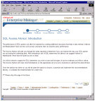

Automatic Database Diagnostic Monitor
SGA
In-memory
statistics
MMON
60
minutes
EM
Snapshots
ADDM
results
ADDM
ADDM
results
AWR
Notes:
Automatic Database Diagnostic Monitor
ADDM is a server-based performance expert in a box. It is automatically used for proactive and effective tuning of your database. ADDM runs automatically at predefined intervals and analyzes system performance. It identifies all kinds of potential performance problems including poorly performing SQL. Thus, the task of high-load SQL identification is performed automatically by ADDM and you simply need to look at the ADDM report to see its recommendations.
By default, the database automatically captures statistical information every 60 minutes from the SGA and stores it in the AWR in the form of snapshots. These snapshots are stored on disk. Additionally, ADDM is scheduled to run automatically by MMON, a new background process introduced in Oracle Database 10g to detect problems proactively. Each time a snapshot is taken, ADDM is triggered to do an analysis of the period corresponding to the last two snapshots. Such a capability proactively monitors the instance and detects all types of performance bottlenecks, such as poor memory configuration or poorly performing SQL statements, before they become a significant problem.
The results of each ADDM analysis are stored inside the AWR and are accessible as well through the EM console and command-line interface.

Slide 7


ADDM Output
ADDM
results
ADDM
EM
AWR
Recommendations
Findings
with impact
Invoke
advisors
Notes:
ADDM Output
ADDM output is best viewed using the EM console. After each analysis, ADDM reports information about findings with corresponding impact on the database. The impact is measured by the percentage of database time spent: Had the problem not existed, the database time would have been reduced by that percentage. The ADDM findings include symptoms and root causes.
ADDM also produces a set of recommendations with associated benefits and rationales. The recommendations can also include information to further call server-based advisors for more detailed analysis of a particular problem.
ADDM output is also stored in the AWR for history purposes.

Slide 8

Manual Identification: Top SQL
SQL
workload
Top SQL
High-load
SQL
SQL Tuning Advisor
Notes:
Manual Identification: Top SQL
Another source for identifying high-load SQL is the list of top SQL statements shown on the EM screen. These top SQL statements are captured by the AWR based on their cumulative execution statistics within the selected time window. The top SQL statements can be ranked on associated statistics such as CPU consumption, elapsed time, buffer gets, and so on. The user can select one or more top SQL statements identified by their SQL ID and launch the SQL Tuning Advisor to tune them.
SQL Tuning Set (STS)
A SQL Tuning Set is a new object for tuning multiple SQL statements and managing SQL workloads. An STS is a database object that stores one or more SQL statements along with their execution statistics and execution context, and possibly with user priority ranking. The SQL statements can be loaded into an STS from different SQL sources. The SQL sources include a list of top SQL statements, the Automatic Workload Repository (AWR), the cursor cache, and specific SQL that you need analyzed. You can select the SQL statements of interest from the Top SQL page and either tune them right away or create an STS that stores the selected SQL statements along with their execution context for later tuning. EM also lets you look at various STSs created by different users. STSs are used as a source for custom SQL tuning by the SQL Tuning and Access Advisors.

Slide 9
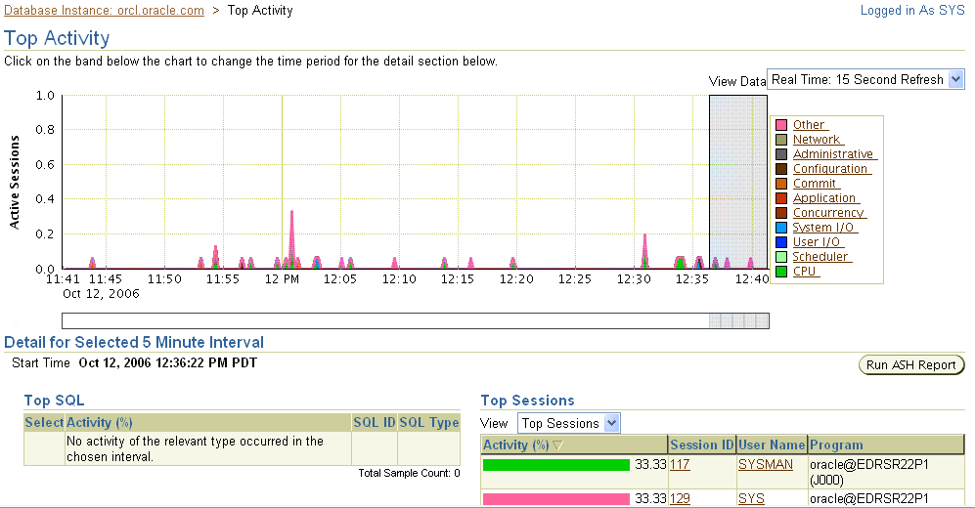
Top SQL
Notes:
TOP SQL
This slide shows how SQL statements can be selected from the Top Activity page to be given as input to the SQL Tuning Advisor. The Top Activity page has two sets of data: Top SQL and Top Sessions. The illustration shows the contents of the Activity SQL page.
If you are most concerned with CPU, then examine the top SQL statements that have highest CPU_TIME during that interval. Otherwise, start with the SQL statement that performed the most DISK_READS.
To access these pages, select EM home page > Performance page > Additional Monitoring Links > Top Activity.

Slide 10
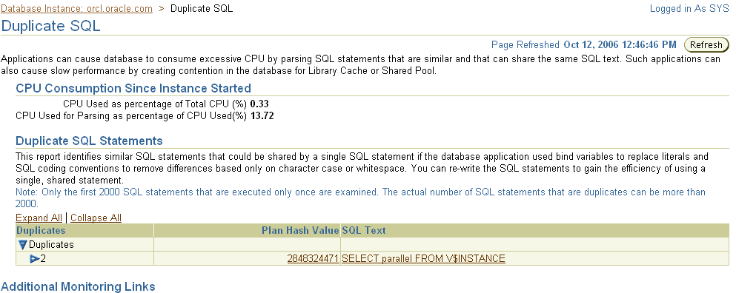
Duplicate SQL
Notes:
Period SQL
The graphic shows the Duplicate SQL page. This report identifies similar SQL statements that could be shared by a single SQL statement if the database application used bind variables to replace literals and SQL coding conventions to remove differences based only on character case or whitespace. You can re-write the SQL statements to gain the efficiency of using a single, shared statement.

Slide 11
Manual Identification: Statspack
Statspack:
  Collects data about high-load SQL
  Precalculates useful data
    Cache hit ratios
    Transaction statistics
  Uses permanent tables owned by the PERFSTAT user to store performance statistics
  Separates data collection from report generation
  Uses snapshots to compare performance at different times
Notes:
Statspack
Statspack is a set of SQL, PL/SQL, and SQL*Plus scripts that allow the collection, automation, storage, and viewing of performance data. Statspack offers yet another way of identifying high-load SQL statements. Statspack collects performance data and produces reports, which in addition to high-load SQL statements include an instance health and load summary page, and the traditional wait events and initialization parameters. Statspack can be used with the Standard Edition of Oracle Database if ADDM is not available. For more information, please see the Statspack appendix in this course.
The main features of Statspack are that it:
Collects data about high-load SQL.
Precalculates many ratios that are useful for performance tuning
Uses permanent tables owned by the PERFSTAT user to store performance statistics. You can take snapshots at different times to compare performance statistics.
Separates data collection from report generation. Data is collected when a snapshot is taken. The performance engineer then runs the performance report and views the data collected.
Makes data collection easy to automate using either DBMS_JOB or an operating system utility to schedule collection tasks
Note: For more information about Statspack, see Appendix E.

Slide 12
Using Dynamic Performance Views
  Select a slow performing period of time to identify high-load SQL.
  Gather operating system and Oracle statistics
  Identify the SQL statements that use the most resources.
Notes:
Using Dynamic Performance Views
Dynamic performance views can also be used in identifying high-load or top SQL statements that are responsible for a large share of the application workload and system resources. This is done by reviewing past SQL execution history that is available in the system.
Using dynamic performance views involves the following steps:
1. Determine which period in the day you would like to examine; typically, this is an application's peak processing time, when it is performing slowly.
2. Gather operating system and Oracle statistics at the beginning and end of that period. The minimum statistics gathered should be:
System statistics from the V$SYSSTAT view
SQL statistics from the V$SQLAREA view
3. Using the data collected in step 2, identify the SQL statements that use the most resources. A good way to identify candidate SQL statements is to query V$SQLAREA. V$SQLAREA contains resource-usage information for all SQL statements in the shared pool. The data in V$SQLAREA should be ordered by resource usage.

Slide 13
V$SQLAREA View
Column | Description
SQL_TEXT | First thousand characters of the SQL text
SORTS | Sum of the number of sorts that were done for all the child cursors
EXECUTIONS | Total number of executions, totaled over all the child cursors
DISK_READS | Sum of the number of disk reads over all child cursors
CPU_TIME | CPU time (in microseconds) used by this cursor for parsing/executing/fetching
ELAPSED_TIME | Elapsed time (in microseconds) used by this cursor for parsing, executing, and fetching
Notes:
V$SQLAREA View
The V$SQLAREA view can also be used to identify high-load SQL. You can query this view to find the SQL statements that most require optimization. The ratio of DISK_READS/EXECUTIONS identifies the SQL statements that have the most disk hits per execution. High values of CPU_TIME and ELAPSED_TIME are indications that the statement is slow to execute and uses significant resources. You should also watch for a high number of sorts.
The most common resources are:
CPU time (V$SQLAREA.CPU_TIME, for statements that use high CPU)
Disk reads (V$SQLAREA.DISK_READS, for high-I/O statements)
Sorts (V$SQLAREA.SORTS, for many sorts)
One method to identify the SQL statements that create the highest load is to compare the resources used by a SQL statement to the total amount of that resource used in the period. For CPU_TIME, divide each SQL statement’s CPU_TIME by the total CPU_TIME for the period.

Slide 14
Querying the V$SQLAREA View
SELECT sql_text, disk_reads , sorts,
cpu_time, elapsed_time
FROM v$sqlarea
WHERE upper(sql_text) like '%PROMOTIONS%'
ORDER BY sql_text;
Notes:
Querying the V$SQLAREA View
The slide shows an example of querying the statistics for a specific query from V$SQLAREA. You can also query for a specific user by joining PARSING_USER_ID with the USER_ID column of the DBA_USERS view. Additionally, you can query for large values for DISK_READS (excess of 100,000).
The output for this query is as follows:
SQL_TEXT DISK_READS BUFFER_GETS SORTS CPU_TIME ELAPSED_TIME
-------- ---------- ------------ ------ -------- ------------
select 23078 16166 5 17225551 20001832
c.CUST_
GENDER, …

Slide 15
Investigating Full Table Scan Operations
SELECT name, value FROM v$sysstat
WHERE name LIKE '%table scan%';
NAME VALUE --------------------------------------------- --------
table scans (short tables) 217842
table scans (long tables) 3040
table scans (rowid ranges) 254
table scans (cache partitions) 7
table scans (direct read) 213
table scan rows gotten 40068909
table scan blocks gotten 1128681
Notes:
Investigating Full Table Scan Operations
A full table scans (FTS) on a large table is a very resource-intensive operation that should be minimally used. To find out if you have too many FTS operations in the database, you can query the V$SYSSTAT view during an application’s peak usage time (as shown).
The results of the query provide an overview of how many full table scans are taking place.
The values for table scans (long tables) and table scans (short tables) relate to full table scans. A long table is defined as having blocks greater than 25 of the buffer cache; a short table has blocks fewer than or equal to 25 of the buffer cache.
If the value of table scans (long tables) is high, then a large percentage of the tables accessed were not indexed lookups. Your application may need tuning, or you should add indexes. Make sure that the appropriate indexes are in place and valid. As you create indexes on your large tables, the FTS number should decrease. If it does not, the wrong indexes are being created.

Slide 16
Summary
In this lesson, you should have learned about the different methods of identifying high-load SQL:
  ADDM
  Top SQL
  Statspack
  Dynamic performance views
Notes:
Summary
Identifying high-load (problematic) SQL is the first step in the SQL tuning process. In this lesson, you should have learned about the different tools available for identifying high-load SQL.

